Slide 1

Lovely Pollen (Android Application)

Slide 2

Lovely Pollen——Background
Causes of Pollen Allergy in North America
1. High rate of vegetational cover
2. Immigration effect
3. Species diversity
https://www.healthy-holistic-living.com/real-cause-seasonal-allergies-hint-pollen.html

Slide 3
Lovely Pollen – demo functions
We have:
Observation in home
People can use this app in home before they want to go outside. Avoid high pollen density city.
Login
The target users are pollen allergy people.
Get data in time
Acquire the weather and pollen data in the meantime.
We will have:
Users help users
Users can upload the local experience to this app and help other people in the future.
Lovely Pollen on Web Service
We are doing pollen forecast based on web and GIS.

Slide 4
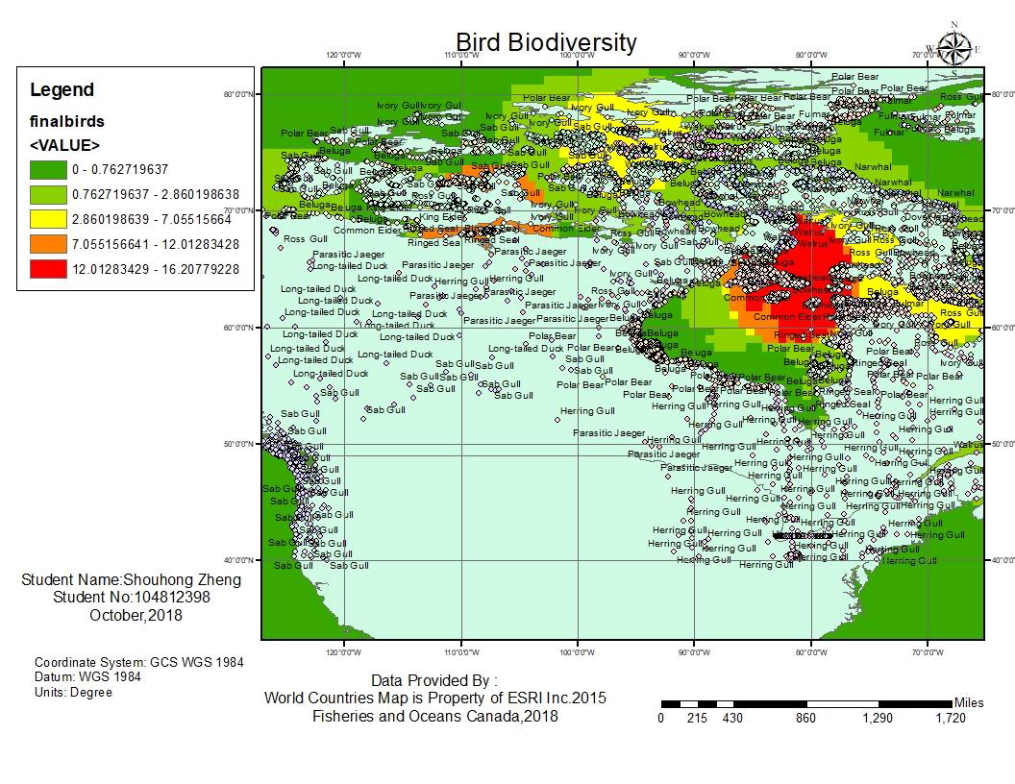
Lovely Pollen——Next to do
What ArcGIS can do?
Geospacial Analysis
Density Analysis

Slide 5
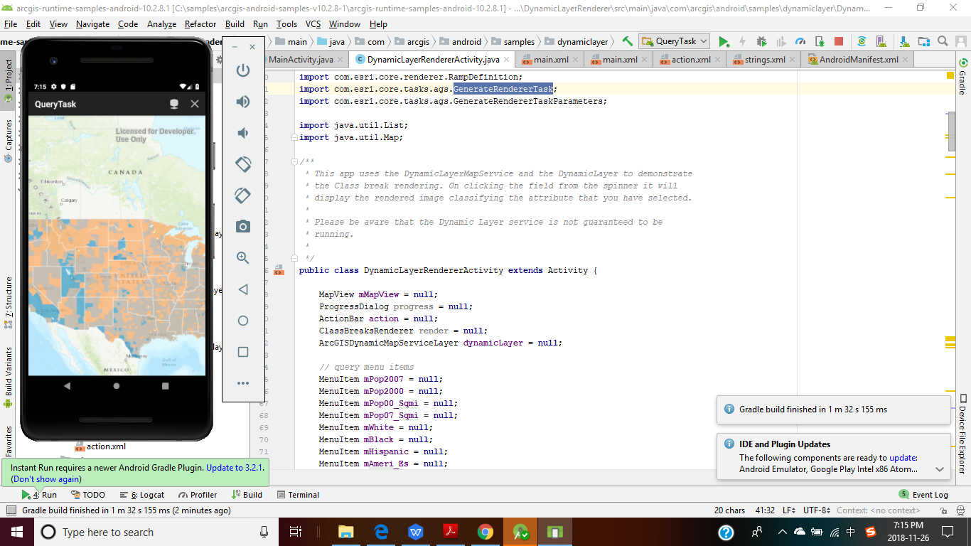
Lovely Pollen——Next to do
Demo
Lovely Polle——Next to do

Slide 6
Looking Foreward
Using more professional data source in commerce.
Clients’ communication platform for sharing tips, helping each other.
Using tremendous scale of data to build a mathematical model for pollen forecast.
...... (to be continued)

Slide 7
THANK YOU

